Slide 1
THEORETICAL IMPEDIMENTS
TO MACHINE LEARNING
WITH SEVEN SPARKS FROM
THE CAUSAL REVOLUTION
Judea Pearl
University of California, Los Angeles
judea@cs.ucla.edu

Slide 2
OUTLINE
Model-blind machine learning is a curve-fitting exercise – slow and dumb
The 3-level causal hierarchy
What we are missing by depriving ML of causal models
The Seven Sparks of the Causal Revolution

Slide 3
CAUSAL MODELS AND THE COGNITIVE REVOLUTION
10,000 years ago, human beings accounted for less than a tenth of 1 percent of all vertebrate life on planet Earth.
  Today, that percentage, including livestock and pets, is in the neighborhood of 98!
  (Daniel Dennett, 2006)
What Happened?
What computational facility did humans acquire 10,000 years ago that they did not possess before?

Slide 4
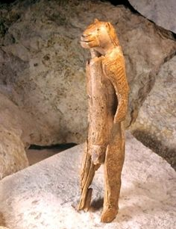
COUNTERFACTUALS:
THE HOMOSAPIENS’ SECRET

Slide 5
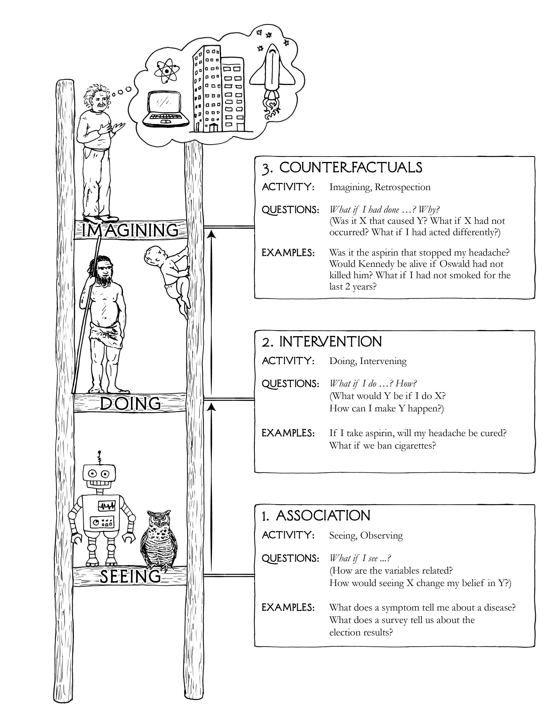
3-LEVEL HIERARCHY
COUNTERFACTUALS
ACTIVITY: Imagining, Retrospection
QUESTIONS: What if I had done . . . ? Why?
(Was it X that caused Y? What if X had not occurred? What if I had acted differently?)
EXAMPLES: Was it the aspirin that stopped my headache?
Would Kennedy be alive if Oswald had not killed him? What if I had not smoked the last 2 years?
INTERVENTION
ACTIVITY: Doing, Intervening
QUESTIONS: What if I do . . . ? Why?
(What would Y be if I do X?
How can I make Y happen?)
EXAMPLES: If I take aspirin, will my headache be cured?
ASSOCIATION
ACTIVITY: Seeing, Observing
QUESTIONS: What if I see . . . ?
(How are the variables related?
How would seeing X change my belief in Y?)
EXAMPLES: What does a symptom tell me about a disease?
What does a survey tell us about the election results?

Slide 6
PREDICTION, INTERVENTION,
AND COUNTERFACTUALS
U₁
l
W
U₂
P – Price
Q – Demand
I – Income
W – Wages
d₁
d₂
b₂
Q
P
b₁
Questions:
What is the expected value of the demand Q if the price is reported to be P = p₀?
What is the expected value of the demand Q if the price is set to P = p₀?
Given that the current price is P = p₀, what would the expected value of the demand Q have been if we were to set the price at P = p₁?
E [Q | P = p₀]
E [Q | do(P = p₀)]
E [Q_{P = p} | P = p₀]
₁

Slide 7

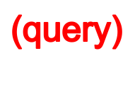
THE STRUCTURAL CAUSAL MODEL (SCM)
A BI-LINGUAL LOGIC FOR CAUSAL INFERENCE
Semantic
G
Q
Causal Diagram
Counterfactual Language
(To specify what we
know − Assumptions)
(To specify what we wish to know − Queries)
U
P(X,Y,Z)
P(Y | do(x))
X
Z
Y
Data
(selected)
_x0016_
G
Q
estimation
Causal
Inference
_x0016_
E_{S} (Q)
Q
estimand

Slide 8
THE SEVEN PILLARS
Pillar 1: Transparency and Testability of Causal
Assumptions
Pillar 2: The control of confounding
Pillar 3: Counterfactuals Algorithmization
Pillar 4: Mediation Analysis and the Assessment
of Direct and Indirect Effects
Pillar 5: External Validity and Sample Selection Bias
Pillar 6: Missing Data (Karthika Mohan, 2017)
Pillar 7: Causal Discovery

Slide 9
PILLAR 1:
MEANINGFUL COMPACT REPRESENTATION FOR CAUSAL ASSUMPTIONS
Task: Represent causal knowledge in compact, transparent, and testable way.

Slide 10
PILLAR 1:
MEANINGFUL COMPACT REPRESENTATION FOR CAUSAL ASSUMPTIONS
Task: Represent causal knowledge in compact, transparent, and testable way.
Are the assumptions plausible? Sufficient?
9

Slide 11
PILLAR 1:
MEANINGFUL COMPACT REPRESENTATION FOR CAUSAL ASSUMPTIONS
Task: Represent causal knowledge in compact, transparent, and testable way.
Are the assumptions compatible with the available data? If not, which needs repair?
9

Slide 12
PILLAR 1:
MEANINGFUL COMPACT REPRESENTATION FOR CAUSAL ASSUMPTIONS
Task: Represent causal knowledge in compact, transparent, and testable way.
Result: Transparency and testability galore
Graphs map scientific knowledge
Graphical criteria tell us, for any pattern of paths, what pattern of dependencies hold in the data.
9

Slide 13
PILLAR 2:
THE CONTROL OF CONFOUNDING
Problem: Determine if a desired causal relation can be estimated from data and how.
Solution: The menace of Confounding has been demystified and “deconfounded”
“back-door” – reduces covariate selection to a game
“front door” – extends it beyond adjustment
do-calculus – predicts the effect of policy interventions whenever feasible
10

Slide 14
PILLAR 3:
THE ALGORITHMIZATION OF COUNTERFACTUALS
Task: Given {Model + Data}, determine what Joe's salary would be had he had one more year of education.
Solution: Algorithms can tell us if/how the probability of any counterfactual sentence is estimable from experimental or observational studies, or combination thereof.
How?
Every model determines the truth value of every counterfactual by a toy-like “surgery” procedure.
Corollary: “Causes of effect” formalized
11

Slide 15
PILLAR 4:
MEDIATION ANALYSIS –
DIRECT AND INDIRECT EFFECTS
Task: Given {Data + Model}, Unveil and quantify the mechanisms that transmit changes from a cause to its effects.
Result: The graphical representation of counterfactuals tells us when direct and indirect effects are estimable from data, and, if so, how necessary (or sufficient) mediation is for the effect.
12

Slide 16
PILLAR 5:
TRANSFER LEARNING, EXTERNAL VALIDITY, AND SAMPLE SELECTION BIAS
Task: A machine trained in one environment finds that environmental conditions changed. When/how can it amortize past learning to the new environment?
Solution: Complete formal solution obtained through the do-calculus and “selection diagrams” (Bareinboim et al., 2016)
Lesson: Ancient threats disarmed by working solutions.
13

Slide 17
PILLAR 6:
MISSING DATA (Mohan, 2015)
Problem: Given data corrupted by missing values
and a model of what causes missingness. Determine when relations of interest can be estimated consistently “as if no data were missing.”
Results: Graphical criteria unveil when estimability is possible, when it is not, and how.
Corollaries:
Detecting when the missingness model is testable and when it is not.
Detecting when model-blind estimators can yield consistent estimation and when they cannot.
All results must be query specific.
Missing data is a causal problem.
14

Slide 18
PILLAR 7:
CAUSAL DISCOVERY
Task: Search for a set of models (graphs) that are compatible with the data, and represent them compactly.
Results: In certain circumstances, and under weak assumptions, causal queries can be estimated directly from this compatibility set.
(Spirtes, Glymour and Scheines (2000); Jonas Peters etal (2018))
15

Slide 19
CONCLUSIONS
Model-blind approaches to AI impose intrinsic limitations on the cognitive tasks that they can perform.
The seven tasks described, exemplify what can be done with models that cannot be done without, regardless how big the data.
DATA SCIENCE is only as much of a science as it facilitates the interpretation of data – a two-body problem involving both data and reality.
DATA SCIENCE lacking a model of reality may be statistics but hardly a science.
Human-level AI cannot emerge from model-blind learning machines.
16

Slide 20
Paper available: http://ftp.cs.ucla.edu/pub/stat_ser/r475.pdf
Refs: http://bayes.cs.ucla.edu/jp_home.html
THANK YOU
Joint work with:
Elias Bareinboim
Karthika Mohan
Ilya Shpitser
Jin Tian
Many more . . .

